Slide 1
PHYSICS-INFORMED NEURAL NETWORKS MODELING FOR TUMOR PROLIFERATION.
PRESENTED BY - MOHAMMED YUSUF MUJAWAR
COURSE – DEEP GENERATIVE MODELING FOR PHYSICAL PROCESSES
PROFESSOR – DR. JIAQI GONG
COURSE CODE – CS-691
YOUTUBE LINK –
GITHUB LINK - HTTPS://GITHUB.COM/MOHAMMEDYUSUF-123/PHYSICS-INFORMED-NEURAL-NETWORKS-MODELING-FOR-TUMOR-PROLIFERATION..GIT

Slide 2
CONTENT
Introduction
Objective
Diffusion-Reaction Equation
Physics-Informed Neural Network
Boundary Condition
Training Strategies
Code Walkthrough
Results
Future Work
Conclusion
Acknowledgement

Slide 3
INTRODUCTION
Increase in Machine Learning applications due to more data and advanced computing.
Medical research faces challenges due to data scarcity, affecting model accuracy.
Glioblastoma, a critical brain tumor, lacks sufficient data for traditional neural networks, leading to suboptimal predictions.
Physics-Informed Neural Networks (PINNs) merge physical laws with machine learning, improving prediction accuracy even with limited data.

Slide 4
OBJECTIVE
Implement PINN to accurately model the growth dynamics of glioblastoma, an aggressive brain tumor.
Integrate the Diffusion-Reaction Equation with PINN to capture the biophysical interactions essential for simulating tumor growth within the brain.
Demonstrate data efficiency by showing how PINN can achieve high accuracy with fewer data inputs compared to traditional neural network models.
Achieve robust simulation accuracy that can be validated against known clinical outcomes to enhance the model's applicability to medical treatment planning.
Explore the potential of PINN in revolutionizing medical imaging and personalized treatment plans by providing deeper insights into tumor behavior under various conditions.
Pioneer the use of PINN in oncology, setting a foundation for further research into complex diseases where conventional predictive models are limited by data scarcity.

Slide 5
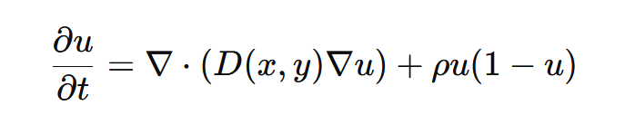
DIFFUSION-REACTION EQUATION
u(x,y,t) represents the tumor cell density at position (x,y) and time t.
D(x,y) is the diffusion coefficient, which varies spatially reflecting differences in tissue properties (e.g., white matter, gray matter).
ρ is the proliferation rate indicating how quickly the tumor cells reproduce.
Diffusion-Reaction equations are important to a wide range of applied areas such as cell processes, drug release, ecology, spread of diseases, industrial catalytic processes.

Slide 6
PHYSICS-INFORMED NEURAL NETWORKS
PINN was developed by Raissi et al., so that it can follow the rule of physics and work with equations in solving problems which are more difficult for traditional neural networks.
Since it uses equations, it doesn’t require much data as that of traditional neural networks. PINNs use loss functions to adhere to the physical laws and equations.

Slide 7
BOUNDARY CONDITIONS
The boundary conditions specify the behavior of the tumor at the edges of the brain tissue domain, which are crucial for the accuracy of the model.
They ensure that the model's predictions remain realistic at the boundaries, reflecting how the tumor would naturally interact with the limits of its environment.
In this model, boundary conditions are applied to the edges of the spatial domain at various time points to simulate the physical constraints that tumor cells encounter.
These conditions guide the neural network, helping to prevent unphysical results and improving the reliability of tumor growth predictions.
Properly modeling these conditions is a critical step in creating a predictive tool that can be used confidently in a clinical setting to plan treatments.

Slide 8
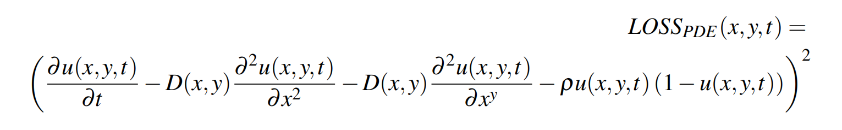
TRAINING STRATEGIES
The training strategy is anchored by a custom loss function composed of three key components: the residual of the Diffusion-Reaction equation, the boundary conditions, and the initial condition setup. These loss function ensures the network's learning is aligned with the physical system. The Loss function for Diffusion-Reaction equation is given above.
We use the Adam optimizer, a popular choice for neural network training, due to its adaptive learning rate capabilities. With a learning rate set at 0.002, the optimizer facilitates efficient convergence while maintaining stability throughout the training process.
Training is conducted over 20,000 epochs to ensure sufficient exposure to the data and allow the network to converge to a solution that accurately reflects the dynamics of tumor growth. This number was determined after preliminary experiments indicated a plateau in performance improvement beyond this point.
The network architecture consists of an input layer tailored to accept spatial (x, y) and temporal (t) coordinates, four hidden layers with 160 neurons each to capture the complexities of tumor growth patterns, and an output layer designed to produce a single continuous value representing the tumor cell density.

Slide 9
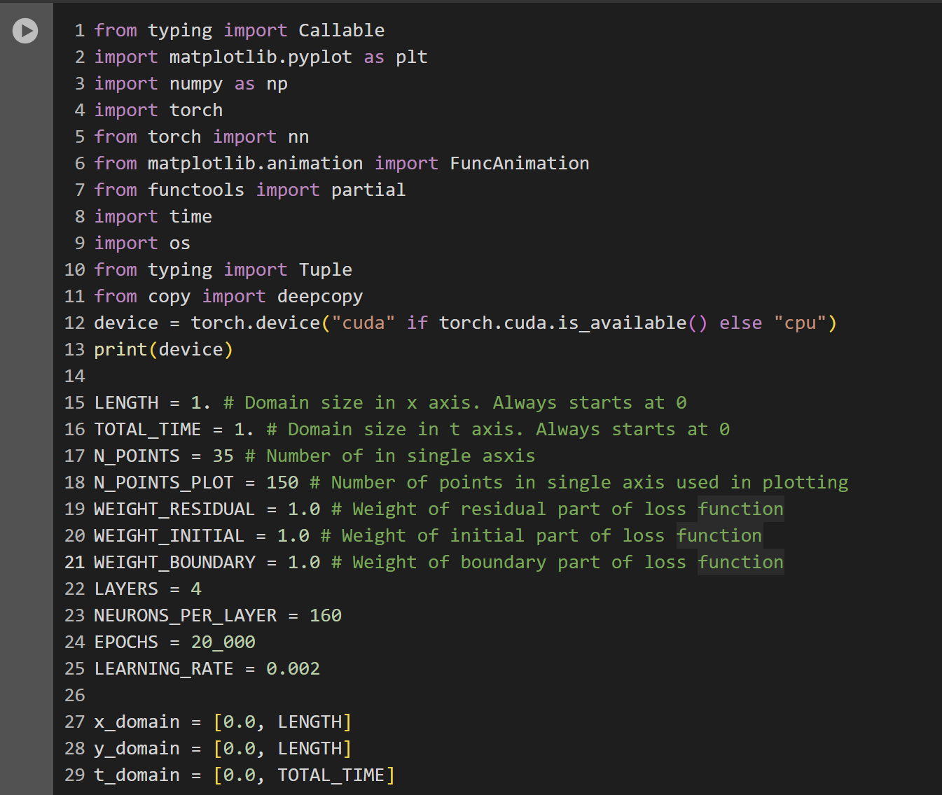
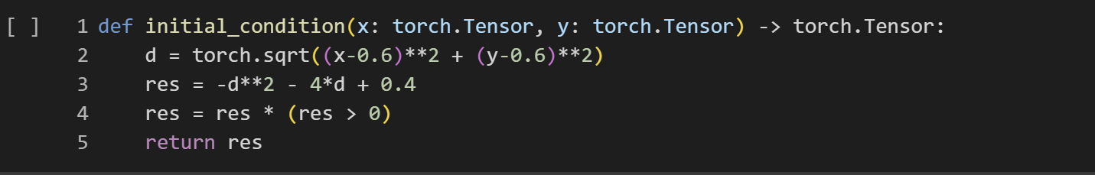
CODE WALKTHROUGH
Library Setup and Customization
Initial Conditional Setup

Slide 10
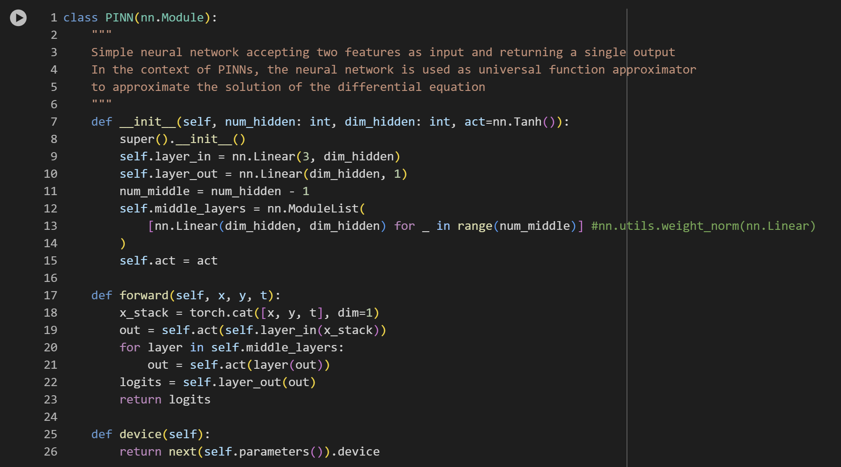
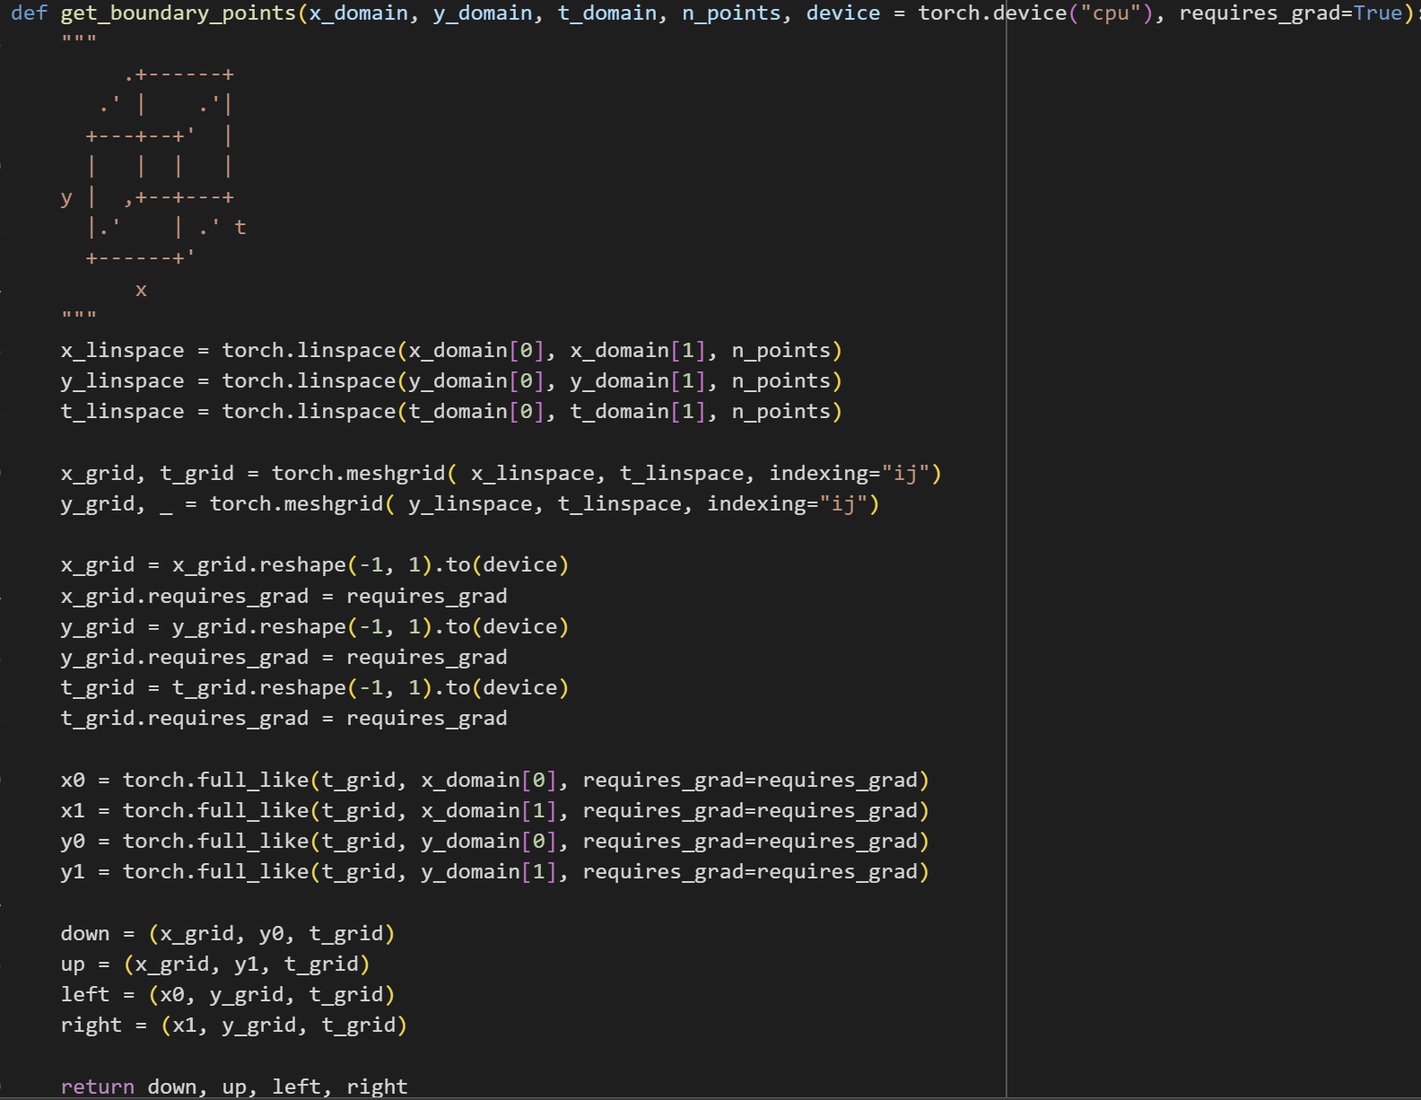
PINN class setup Boundary Condition

Slide 11
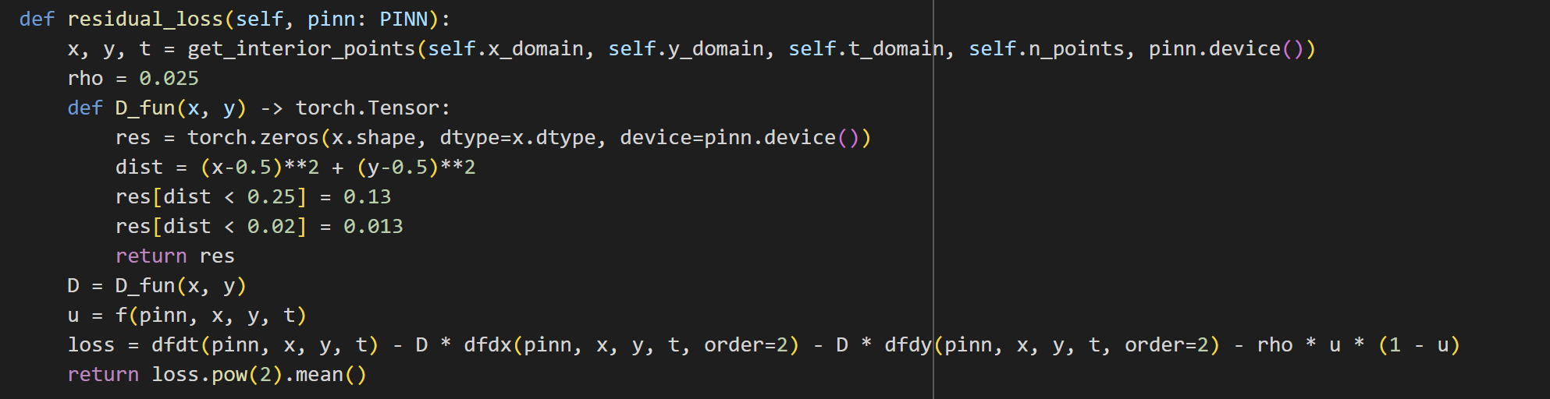
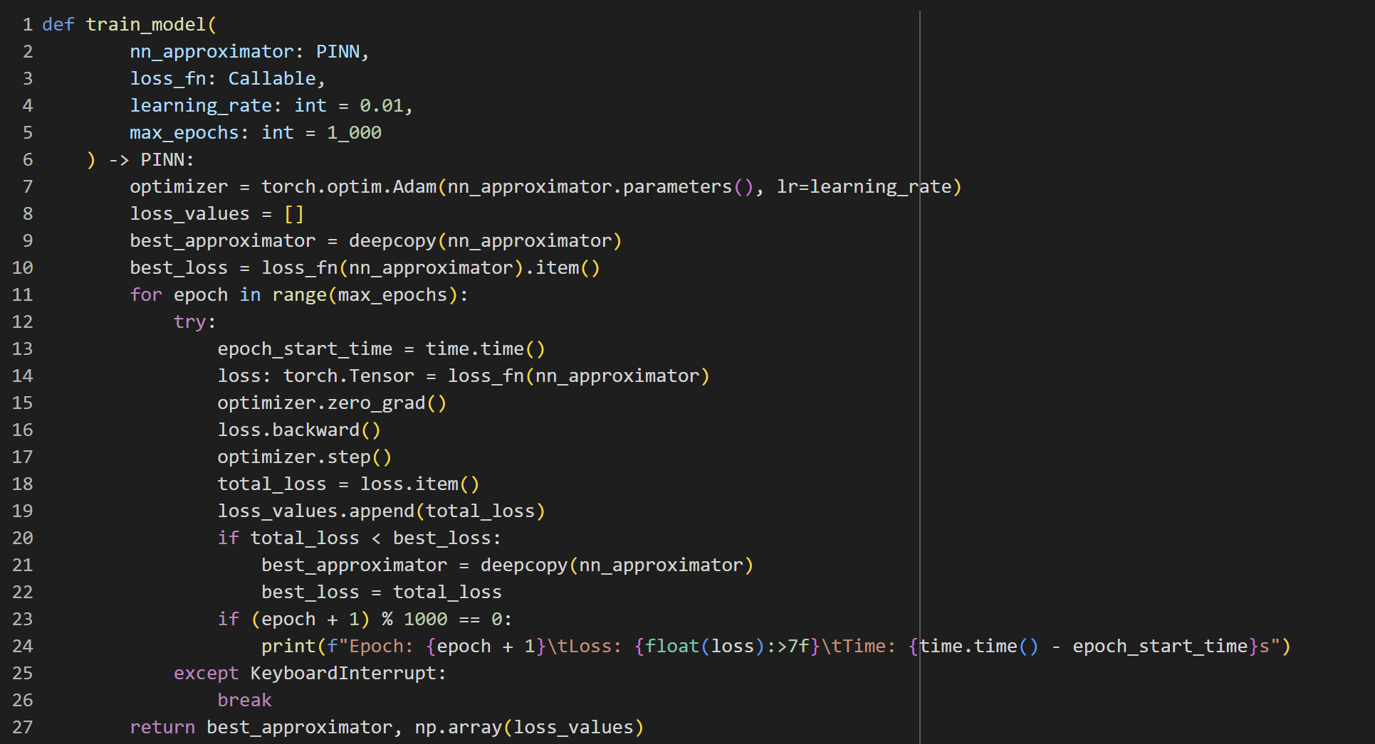
Residual Loss Training Model

Slide 12
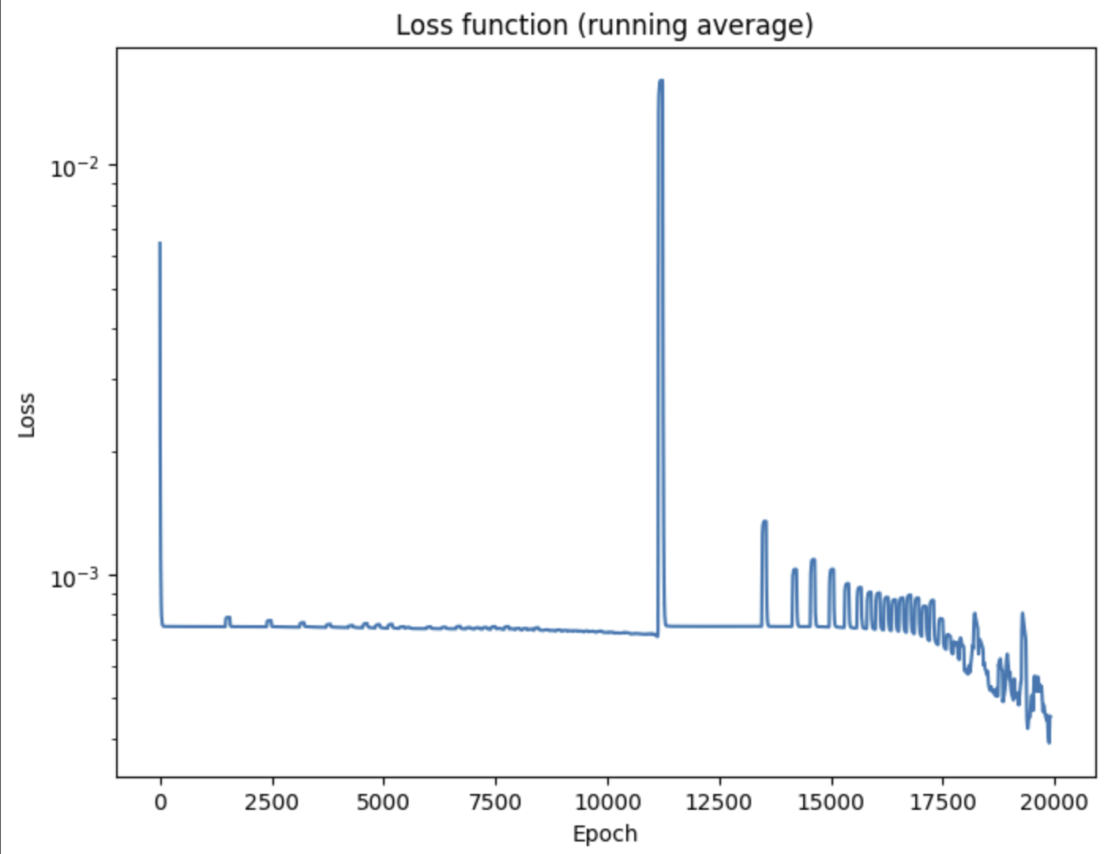
Loss Function

Slide 13
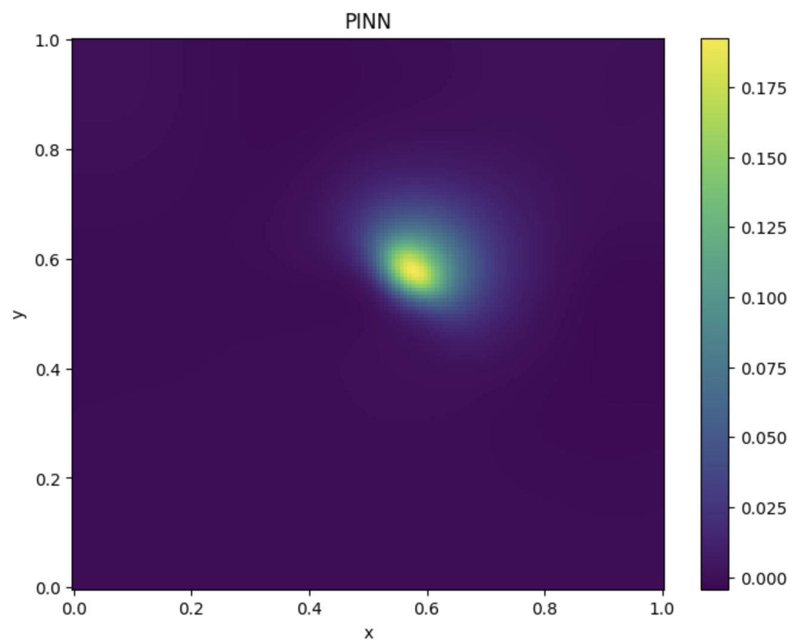
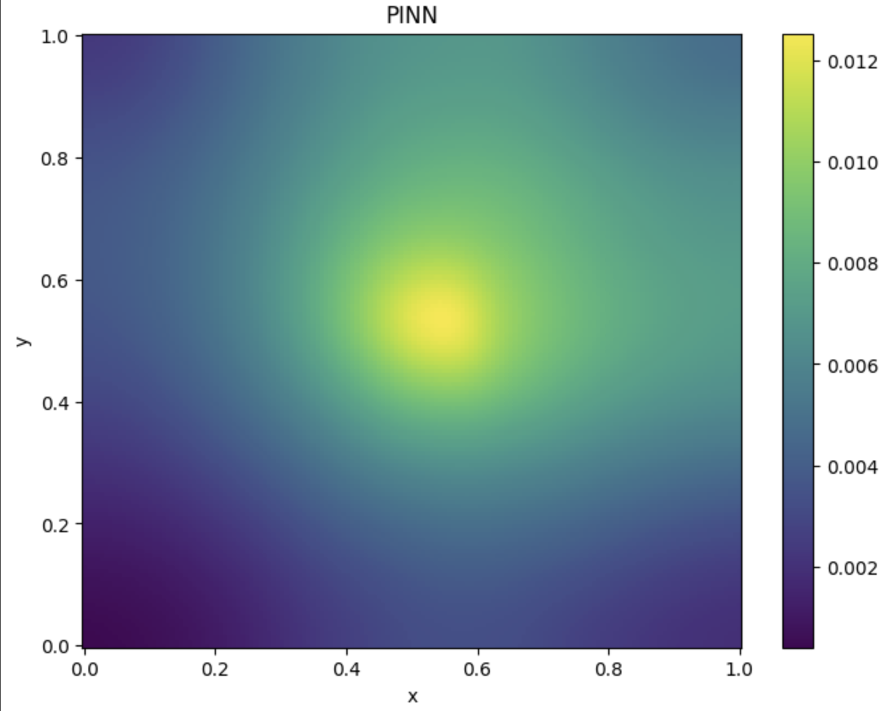
PINN Results

Slide 14
RESULTS
The model's training results in a loss function convergence that indicates the neural network is effectively learning the tumor growth patterns within the specified parameters of the study.
Snapshots of tumor growth simulations at various epochs demonstrate the model's capability to predict the spatial distribution and proliferation rate of glioblastoma cells over time.
Comparisons between the actual initial conditions and the PINN-predicted conditions reveal a high degree of accuracy, showcasing the model's ability to capture the initial state of the tumor accurately.
The final trained model provides a detailed visualization of tumor evolution, reflecting both the diffusion process across brain tissue and the aggressive nature of glioblastoma.
These results underscore the potential of PINNs in medical applications, specifically in the accurate modeling of complex biological processes with limited data.

Slide 15
FUTURE WORK
Furthermore, the research has shed light on the potential of PINNs to advance the field of medical imaging and personalized treatment to treat patients. By capturing the growth of high-grade tumors with minimal data requirements, the project paves the way for developing predictive models that are not only scientifically robust but also clinically relevant.
This research has been one of methodical learning, and application of PINN. The knowledge acquired through the process of implementing PINNs has been substantial, and it can be used for various other applications aside from this project.

Slide 16
CONCLUSION
I have successively demonstrated that Physics-Informed Neural Networks (PINNs) are powerful tools for modeling the complex mechanisms of glioblastoma tumor growth within the brain. By using the Diffusion-Reaction Equation into the PINN framework, the research has bridged the gap between data-driven machine learning techniques and the deterministic nature of physical laws governing biological processes.
The deployment of a custom loss function, reflecting the residual of the governing PDE along with the initial and boundary conditions, ensured that the network's training was robust and grounded in physical accuracy. The model's predictions have been validated against known conditions, and the visualizations of the tumor's evolution provide compelling evidence of the network's ability to predict the aggressive spread of glioblastoma.

Slide 17
REFERENCES
M. Raissi, P. Perdikaris, and G. E. Karniadakis, "Physics-informed neural networks: A deep learning framework for solving forward and inverse problems involving nonlinear partial differential equations," J. Comput. Phys., vol. 378, pp. 686-707, 2019.
Martens C, Rovai A, Bonatto D, Metens T, Debeir O, Decaestecker C, Goldman S, Van Simaeys G. Deep Learning for Diffusion-Reaction Glioma Growth Modeling: Towards a Fully Personalized Model?. 2022 May 20;14(10):2530. doi: 10.3390/cancers14102530. PMID: 35626134; PMCID: PMC9139770.
P. Maczuga et al., "Physics Informed Neural Network for 2D Transient Problems (PINN-2DT) Compatible with Google Colab," 2023.
A. Zhu, "Accelerating Parameter Inference in Diffusion-Reaction Models of Glioblastoma Using Physics-Informed Neural Networks," 2023.

Slide 18
ACKNOWLEDGEMENT
I'd like to thank Prof Dr. Jiaqi Gong for his invaluable support during this research. His course on Deep Generative Modeling for Physical Processes was crucial in helping me understand neural networks and their application in creating generative models. His clear guidance and expertise in teaching have been essential in helping me grasp how neural networks function and how they can be used to solve scientific problems using PINNs, which I've applied in this project. His help has been a foundation for my learning, and for that, I'm truly grateful.

